Slide 1
Maisammaguda, Kompally,
Medchal - Malkajgiri DistrictHyderabad - 500100, Telangana State www.mallareddyuniversity.
(Telangana State Private Universities Act No. 13 of 2020 & G.O.Ms. No. 14, Higher Education (UE) Department)
Department of Computer Science & Engineering
A+Agenda
Batch No.: AD-171
1. 2211CS010541(S.Manoj Kumar)
2. 2211CS010542 (S.Ravi Teja)
3. 2211CS010462 (P.Praharsha)
4. 2211CS010537(S.Srivalli)
Guide Name: Mr.G.Kishore Kumar

Slide 2
CONTENTS
Title Explanation
Abstract of the Application
Introduction to the Application
Problem Statement
Objectives
Methodology
Existing System
Proposed System
Requirements
Design
Block diagram of application
Screenshots
Results
Conclusion
Future Scope
References

Slide 3
Title Explanation:
“A+": The "A+" part of the title might indicate a high-quality or top-rated agenda or calendar application. In many grading systems, an "A+" is the highest possible grade, so it can be seen as a symbol of excellence.
"Agenda": An agenda is a list or schedule of items to be discussed or accomplished, especially at a meeting or event. In the context of a software application, an "agenda" typically refers to a digital calendar or planner used for scheduling and organizing events, appointments, and tasks.
Combining these elements, "A+Agenda" could be a Java application for managing schedules, appointments, and tasks that aims for high quality and excellence in its features and functionality. It's possible that this application may have features that set it apart from other agenda or calendar applications, making it a top choice for users seeking an efficient and user-friendly way to manage their time and events.

Slide 4
Abstract:
Personalize study schedules. Key features include dynamic scheduling, customizable study academic success. Using Java, it offers an easy-to-use interface to create, organize, and Our Study Scheduling Java Application helps students manage their time effectively for Our Study Scheduling Java Application helps students manage their time effectively for academic success. Using Java, it offers an easy-to-use interface to create, organize, and personalize study schedules. Key features include dynamic scheduling, customizable study sessions, reminders, progress tracking, and analysis tools. By enhancing productivity and promoting efficient study planning, the application supports learners in reaching their academic goals.sessions, reminders, progress tracking, and analysis tools. By enhancing productivity and promoting efficient study planning, the application supports learners in reaching their academic goals.

Slide 5
Introduction:
In the fast-paced world we live in, managing our time efficiently has never been more crucial. That's where A+Agenda steps in as your ultimate time management companion. This Java application is more than just a calendar; it's a sophisticated tool designed to help you make the most of your precious hours and days.
A+Agenda is your personalized assistant for scheduling appointments, tracking events, and staying on top of your tasks. With its user-friendly interface and a rich set of features, it offers a seamless and intuitive way to organize your life. Whether you're a professional trying to balance work and personal commitments, a student juggling classes and extracurricular activities, or anyone who values time, A+Agenda has you covered.
Join us on a journey through the features and functionalities of A+Agenda, and discover how this Java
application can transform the way you manage your time and make every day an A+ day.

Slide 6
Problem Statement:
In today's fast-paced and increasingly complex world, effective time management and organization are paramount for individuals, students, professionals, and businesses. The traditional methods of using paper calendars and manual to-do lists are often insufficient to meet the demands of modern life. Digital solutions exist, but many fall short in providing a comprehensive, user-friendly, and secure platform for managing schedules, tasks, and events. Users frequently struggle with cluttered interfaces, inadequate customization options, and potential data security concerns. A+Agenda aims to address these issues and provide a solution that prioritizes user experience, customization, cross- platform compatibility, and data security, ultimately empowering users to manage their time efficiently, reduce stress, and achieve their goals.

Slide 7
Objectives:
The primary objectives of A+Agenda, our Java application, are to streamline time management and organization for our users. With a user-friendly interface, we aim to provide a seamless scheduling and calendar management experience that can be personalized to individual preferences. Our cross-platform compatibility ensures accessibility from various devices, while efficient task and to-do list management, coupled with a robust reminder and notification system, keeps users on top of their commitments. We prioritize data security and integration with other productivity tools, offering collaborative features for teams or families. A+Agenda also empowers users with reporting and analytics to track their time management patterns and continuous updates to meet evolving needs. Coupled with dedicated customer support, we aspire to become the ultimate time management companion, helping users make every day an A+ day.

Slide 8
Methodology:
The methodology for developing A+Agenda, our Java application designed for efficient time management and organization, is a structured and comprehensive process. It begins with a thorough analysis of user requirements, encompassing features such as scheduling, task management, and customization. A well-defined system design is created, outlining the application's architecture, database structure, and user interface. Development follows industry best practices, including robust security measures, while quality assurance ensures the application performs reliably and responsively. The user interface is designed for intuitive navigation and personalization, with a focus on cross-platform compatibility. Data security and privacy are efficient, with compliance to data . User documentation and training resources are provided, and continuous improvement is facilitated through user feedback. After deployment, monitoring and support channels are established to ensure a seamless user experience. This methodology ensures that A+Agenda becomes a user-friendly, secure, and adaptable tool for effective time management.

Slide 9
Existing System:
Existing A+Agenda systems facilitate effective time management and task organization by allowing users to allocate study time for different subjects and tasks. They often integrate with calendars, offer customization options, and include progress tracking tools. These systems support resource management, collaboration, and provide analytics for insights into study habits. Motivational features, user-friendly interfaces, and cross-platform accessibility are common, along with integration with academic systems for seamless import of schedules and deadlines. Overall, these systems aim to enhance the study experience and improve academic performance.

Slide 10
Proposed System:
In response to the increasing demand for effective study management tools, we propose the development of the A+AGENDA Web App, designed to empower students with an intuitive platform for streamlined organization and optimization of study routines. This comprehensive system seamlessly integrates with Google Drive, allowing users to conveniently centralize study resources and tasks. The A+AGENDA Web App features a visually engaging dashboard that provides real-time overviews of subjects to study, displaying upcoming tasks and key performance metrics for quick insights into study progress. The user-friendly subjects management system enables effortless addition, editing, and removal of subjects, while customization options offer a personalized study experience.
A streamlined task entry form, complete with auto-suggestions for subjects, enhances user efficiency. The app's integration with Google Drive is facilitated by the Google Picker API, allowing users to access and manage study resources with ease. To optimize study strategies, the Study Planner Web App offers analytics and reports, including visual representations of study patterns, completion rates, and time allocation. This data-driven approach aims to contribute to effective academic planning. Technologically, the app employs cutting-edge tools like Node.js for the backend and React.js for the frontend, ensuring a responsive and robust user experience. A reliable database management system securely stores user profiles, subjects, tasks, and analytics information. The implementation plan includes cross-browser compatibility testing, emphasizing a seamless user experience. In conclusion, the A+AGENDA Web App revolutionizes student study management with advanced features, seamless Google Drive integration, and a user-centric design, enhancing overall study experiences and contributing to efficient planning and resource management.

Slide 11
Requirements:
Software Requirements:
i.Front-End:
HTML5 and CSS3, JavaScript (ES6+).
ii.Back-End:
Server-Side Language (java),API integration(Google Picker API for accessing and managing Google Drive resources.)
Google drive and google documents and videoplayback.web.
Hardware Requirements Database Server:
i.Processor: Similar to the application server, a multi-core processor for handling database queries
efficiently.
ii.Storage: SSD storage is preferable for faster data retrieval.
iii.RAM: Sufficient RAM for caching and handling database operations. Again, the amount depends on the size of the database.

Slide 12
Design:
In designing the A+AGENDA Web App, a thoughtful approach to user interface elements is crucial. The design incorporates a visually engaging dashboard that offers users a quick overview of their study plan, featuring key metrics such as subjects to study, upcoming tasks, and study progress through interactive charts and graphs. An intuitive navigation system ensures easy access to different sections, such as subject categories, task entry forms, and analytics, enhancing the overall user experience. The expense entry form is streamlined and user-friendly, allowing users to input study tasks effortlessly. Personalization options for the dashboard, preferred themes, and frequently used features contribute to a tailored and personalized experience for each user.
On the other side, the web app prioritizes responsive design, ensuring compatibility across various devices, including desktops, laptops, tablets, and smartphones. Personalization features allow users to customize their dashboard, themes, and frequently used features, tailoring the app to their preferences and study habits. The app incorporates to provide timely updates on study progress, upcoming tasks, and irregular study patterns. Security features, such as encryption icons, are visibly implemented to assure users of the safety of their study data. An accessible onboarding process guides new users through setting up their connecting subjects, and understanding the app's key features.

Slide 13
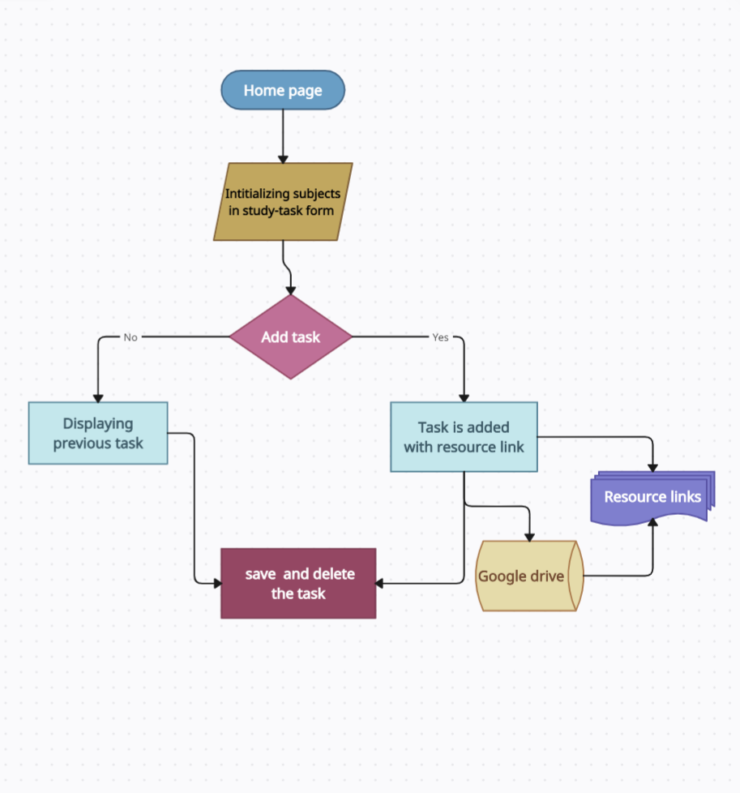
Block diagram of application:

Slide 14
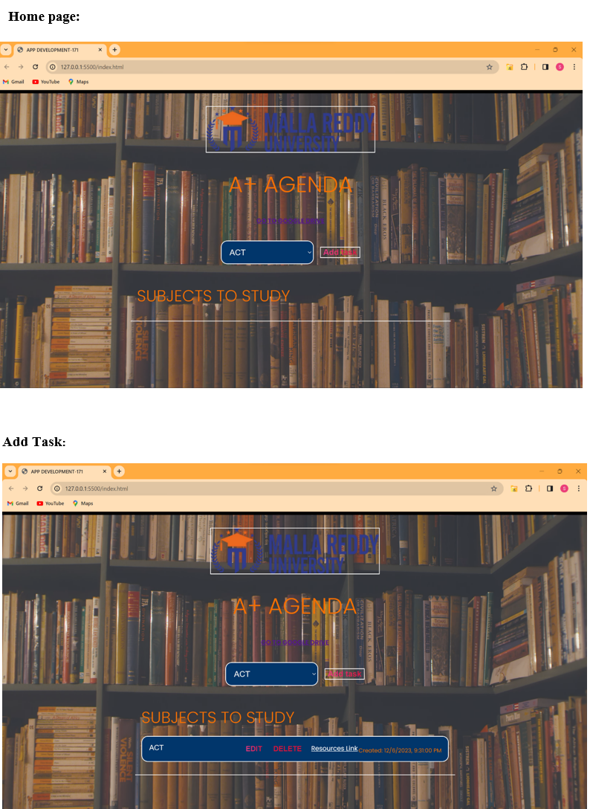
Screenshots:

Slide 15
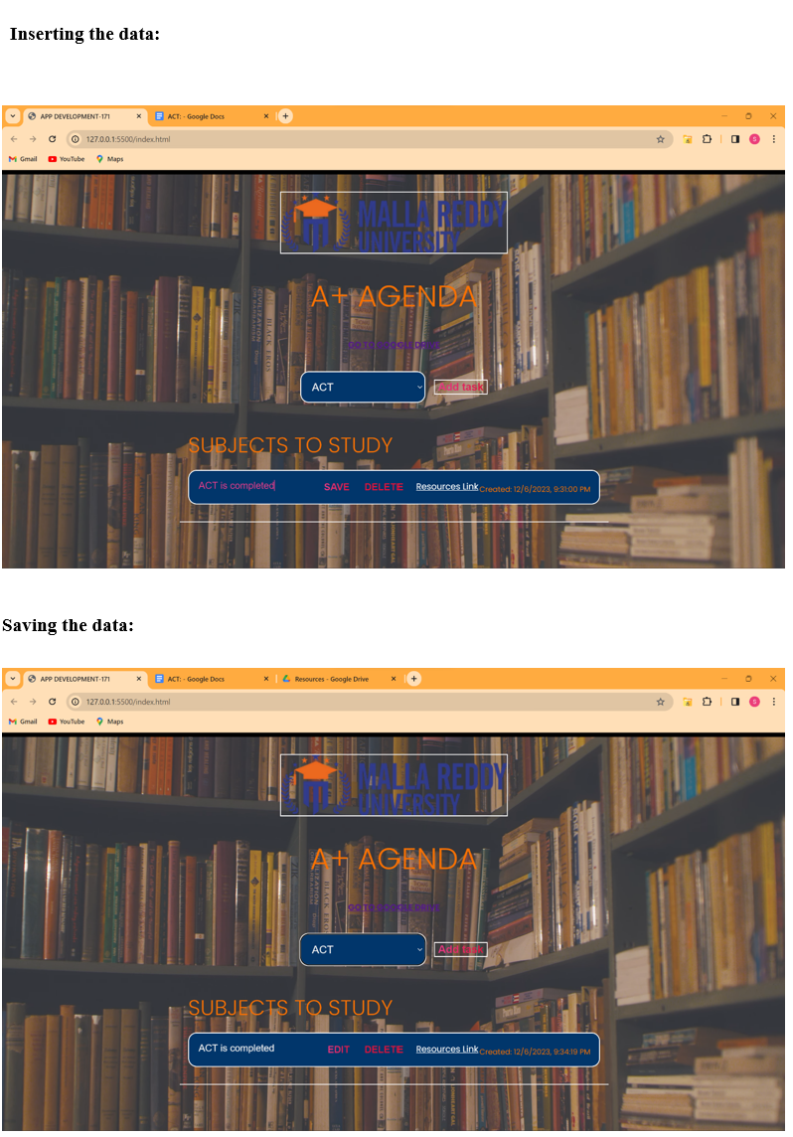

Slide 16
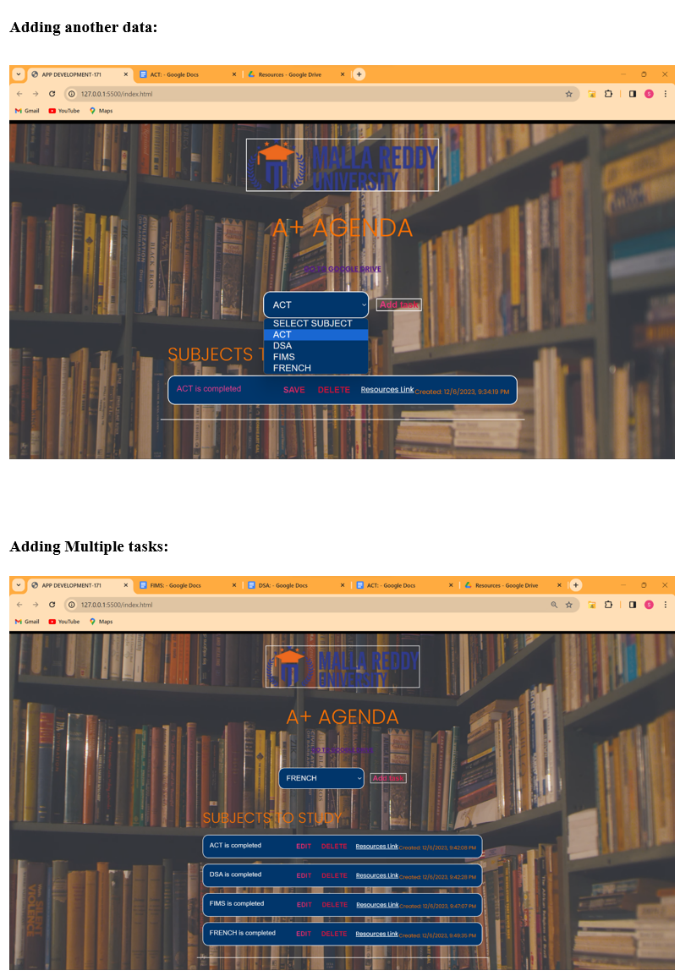

Slide 17
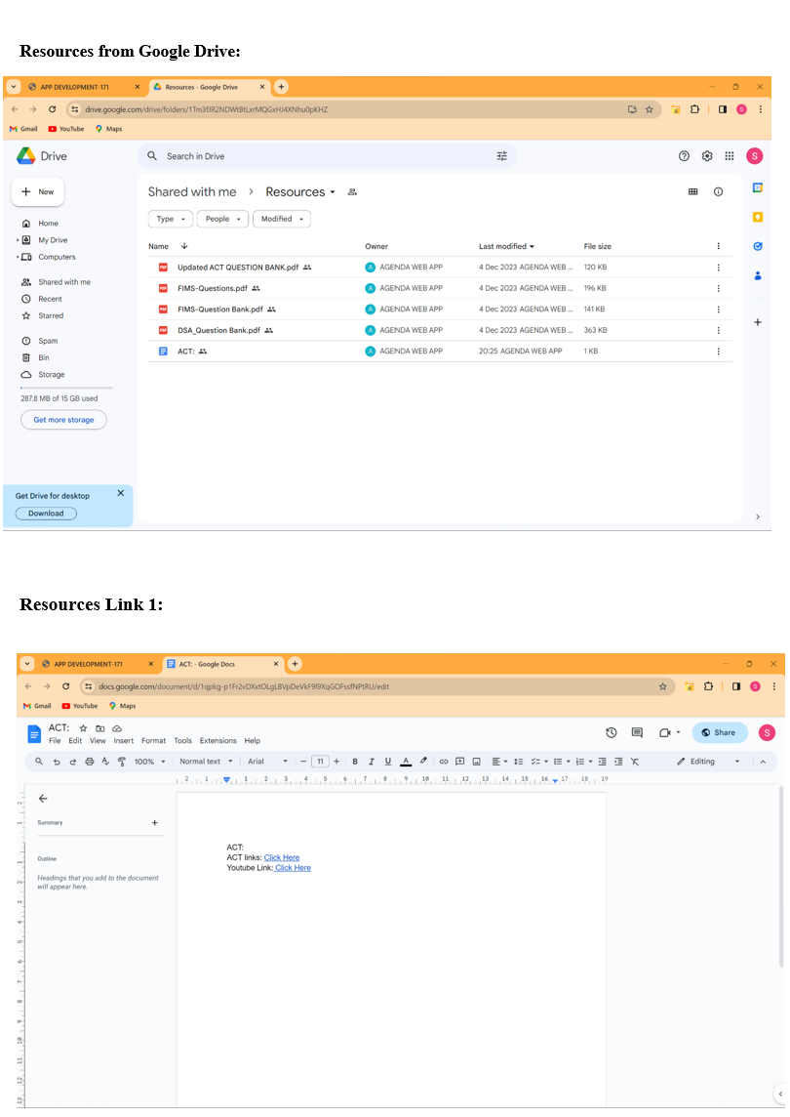

Slide 18
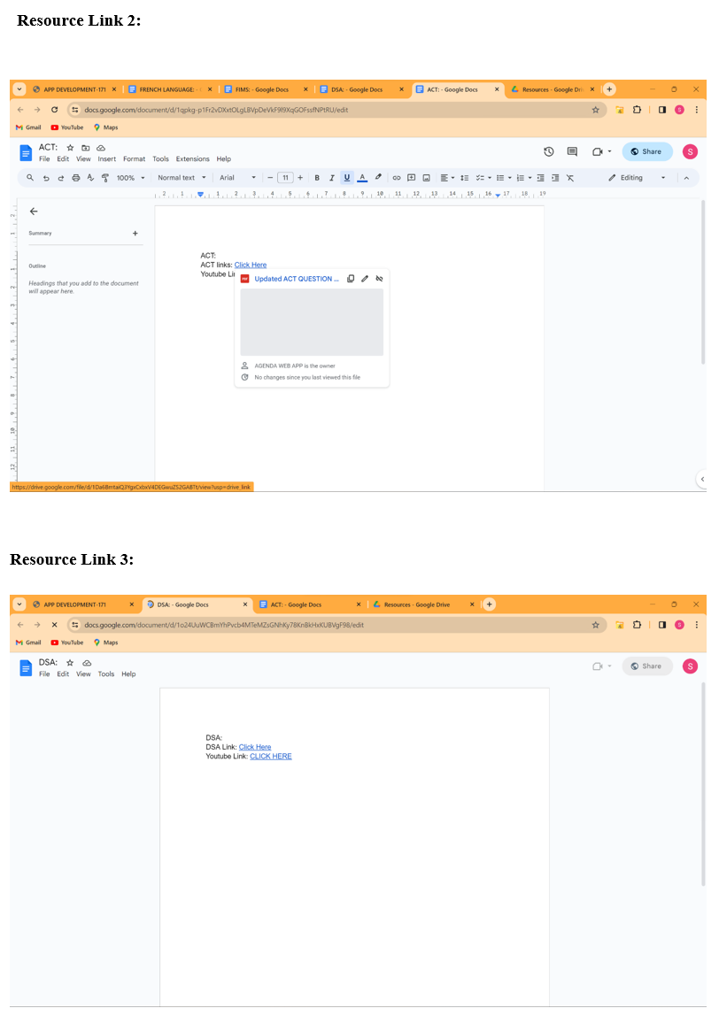

Slide 19
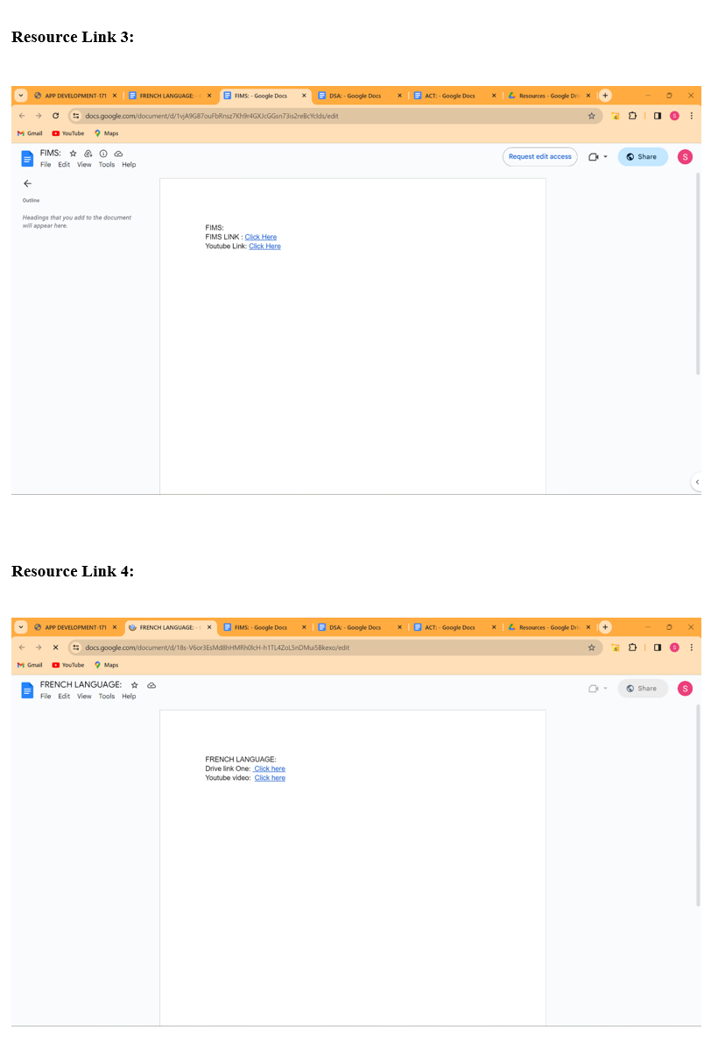

Slide 20
Results:
The A+AGENDA web app has been successfully implemented, offering users a dynamic and user-friendly platform for efficient study schedule management. Leveraging React for the front end and a robust server on the back end, the app enables seamless interactions such as adding, editing, and deleting tasks. Key features include a visually appealing and responsive design, secure storage of user-specific data, and thorough testing for reliability. Deployed on a hosting platform, the app provides a well-rounded solution for students aiming to organize and optimize their study routines.

Slide 21
Conclusion:
In conclusion, A+Agenda stands as a powerful and user-centric Java application
crafted for time
management and organization. With a focus on simplifying the complex landscape of scheduling, task management, and event organization, A+Agenda prioritizes user-friendliness and customization. Its robust architecture, user-friendly interface, and cross-platform compatibility make it a versatile tool for users from all walks of life. A+Agenda takes data security and privacy seriously, ensuring that users can trust it with their most sensitive information. Continuous improvement, driven by user feedback and emerging technologies, guarantees that the application will evolve alongside the changing needs of its users. Whether you're a professional, a student, or anyone seeking efficient time management, A+Agenda is here to empower you. This Java application is not just about managing your time; it's about making every day an A+ day, and making everyone as a ‘A+’ helping you achieve your goals, reduce stress, and optimize your daily routines. Welcome to the future of time management with A+Agenda. Remember that the key to effective study scheduling is finding a method that works best for you. It may require some experimentation and adjustment to discover the schedule and techniques that optimize your productivity and learning.

Slide 22
Future Scope:
The A+Agenda Web App has a promising future with several key enhancements. Developing not only web application and we want to develop mobile applications for iOS and Android platforms would increase accessibility, allowing students to manage study plans on the go. Collaborative features for shared study plans and integration with Learning Management Systems offer opportunities for growth. Incorporating AI for personalized insights, syncing with external calendars, and customizable notifications can enhance usability. Gamification elements, offline mode, and resource management improvements add to the user experience. Multi-language support and in-app tutorials increase usability. These mid-level enhancements position A+Agenda to evolve into a more feature-rich and user-friendly study tool.

Slide 23
References:
"Getting Things Done" by David Allen: This book provides a comprehensive framework for organizing tasks and managing time effectively. While not focused solely on study scheduling, its principles can be applied to academic planning.
"Deep Work: Rules for Focused Success in a Distracted World" by Cal Newport: Cal Newport discusses the importance of deep, focused work and provides practical strategies for managing your time to achieve more in less time.
Online Tools and Apps: There are various online tools and apps designed for study scheduling and time management, such as Trello, Todoist, and Google Calendar. These can help you organize your study sessions
Remember that the key to effective study scheduling is finding a method that works best for everyone. It may require some experimentation and adjustment to discover the schedule and techniques that optimize your productivity and learning.

Slide 24
THANK YOU

